Slide 1
Synthetic Data Generation

Slide 2
Do Synthetic Data (SD) improve the performance of DL models, in a Data Augmentation manner?
Produce high-quality synthetic data
1
Use that data to augment the training data (in the 100s of samples)
2
Achieve better performance and generalization on the DL model
3
Time-series Forecasting
Halcor’s Data -> Monthly Records ( 07/2018 – 08/2021)
Only 38 data points
Downstream task -> Forecasting/Regression(kWh)

Slide 3
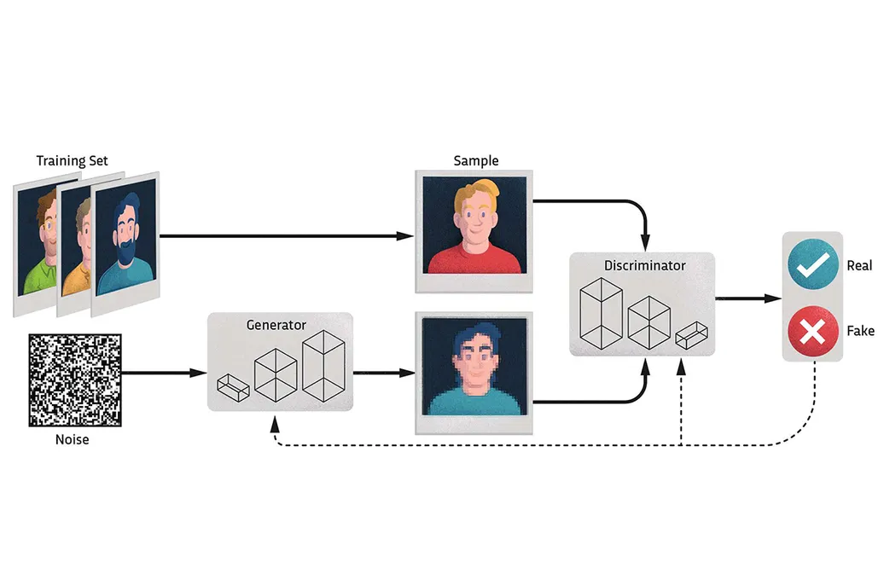
GANs
MiniMax Game: The Generator creates realistic fake samples, while the Discriminator tries to tell real samples from fake ones
Notes:
Over time, this competition improves both networks, resulting in the generator producing very realistic fake samples.
(Με την πάροδο του χρόνου, αυτός ο ανταγωνισμός βελτιώνει και τα δύο networks, με αποτέλεσμα ο generator να παράγει πολύ ρεαλιστικά ψεύτικα δείγματα.)

Slide 4
Time-series GANs
Generation of synthetic data that closely mimics real-world Time-series data and the ability to capture both the temporal dynamics and dependencies of real data.
State-of-the-art
RTSGAN
TimeGAN
Notes:
Time-series GANs einai ypeuthina gia thn Δημιουργία συνθετικών δεδομένων που μιμούνται ακριβώς τα time-series dedomena kai exoun thn dunatotita apotypwsis τόσο twn temporal dynamics όσο και twn dependencies των πραγματικών δεδομένων.
TimeGAN precedes RTSGAN, and worth noting is that RTSGAN also handles missing values in the original data.

Slide 5
Challenges
No straight-forward way to evaluate the synthetic output (Still researching)
Multi-faceted evaluation
Statistical Properties
Visualization (PCA plots, t-SNE plots)
Train-on-Synthetic-Test-on-Real(TSTR)
Train-on-Real-Test-on-Synthetic(TRTS)
Dynamic Time Warping (DTW)
Best amount of original data to produce the best possible synthetic data

Slide 6
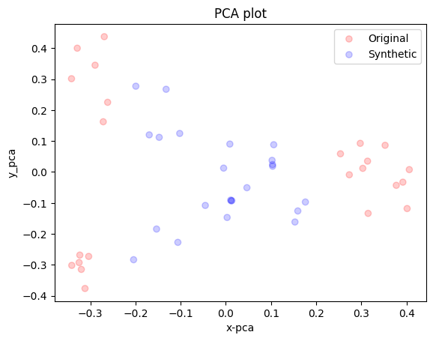
Early Findings
RTSGAN - 10.000 Iterations
Notes:
Principal Component Analysis plot, is a way to visualize data in a simplified manner. It takes complex data with many variables (15 in our case) and projects it into a lower-dimensional space.

